Slide 1

Introduction to recursive algorithms

Slide 2
Outline
In this lesson, we will:
  Introduce algorithm design techniques and recursion
  Introduce three problems that have recursive solutions
  Describe the general approach of recursive algorithms
  Provide pseudo-C++ code for the described three problems
  Looking ahead

Slide 3
Algorithm design techniques
Previously, we looked at explicit algorithms for searching and sorting arrays
We will now look at a specific algorithm design technique
  That is, an approach that can be used to design algorithms
Recursion is one such technique,
and it is the basis for more advanced techniques:
  Divide and conquer
  Dynamic programming

Slide 4
Recursion
The word recursion is derived from the Latin word recurrere
  To run back
This word is also the root for “recur” and “recurrence”
  A recursive algorithm implemented as a function is one that will call itself within that function to solve a problem

Slide 5
Recursion
The idea is very simple:
  Find an algorithm that solves a larger problem by:
    Breaking the larger problem into smaller but similar problems
    Using the same algorithm to solve those smaller problems
    Using the solution of the smaller problems to create a solution for the larger problem
  At some point there must be sufficient small problems that are trivial to solve
    These are called base cases

Slide 6
Queries from a corporate ceo
Here is an example:
  In a company, employees are either workers or managers
    A manager has a direct supervisory role over those reporting directly to that manager
    Some managers are executives, others are senior and intermediate managers
  All employees other than the ceo directly report to one manager
    Managers report directly to either the ceo or another manager
    The only worker to report directly to the ceo is usually the ceo’s personal administrative assistant
  This creates a hierarchy within the company

Slide 7
Queries from a corporate ceo
The ceo may want to know how many employees are attending the Labor Day celebrations
  The ceo asks:
    The ceo’s personal administrative assistant if that person is going
    Each manager directly reporting to the ceo to relay how many employees under them will be attending
  Each manager in turn asks:
    Any workers reporting to them if they will be attending
    Each manager reporting directly to that person to relay how many employees under them will be attending
Each manager will pass down this request, and when each worker has responded, each manager will pass that information back up

Slide 8
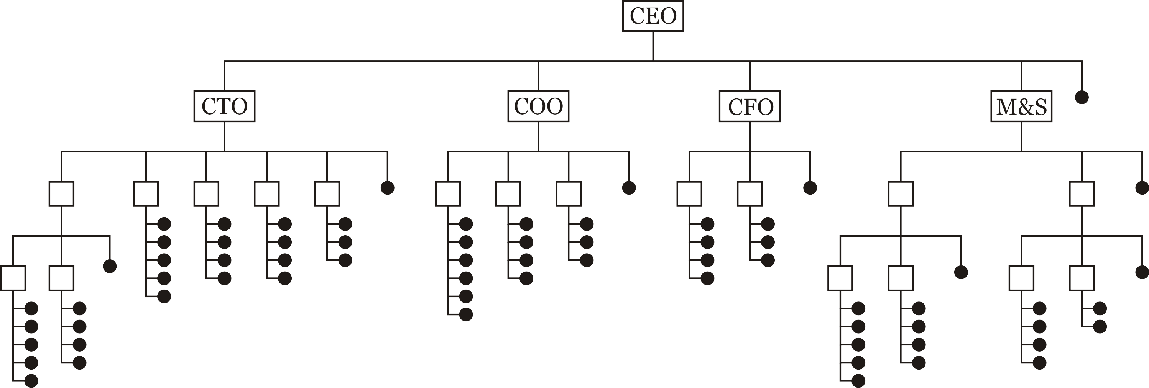
Queries from a corporate ceo
✓
64
22
12
4
24
✓
✓
✓
✓
✓
?
?
?
?
10
2
2
3
3
4
2
4
2
1
13
9
✓
✓
✓
✓
✓
✓
✓
✓
?
✓
✓
✓
?
?
?
?
?
?
?
?
?
?
?
✓
✓
✓
✓
4
4
✓
✓
✓
✓
✓
✓
6
5
5
3
✓
✓
✓
✓
✓
✓
✓
✓
✓
✓
✓
✓
?
?
✓
✓
✓
?
?
?
?
✓
✓
✓
✓
✓
✓
✓
✓
✓
✓
✓
✓
✓
✓
✓
✓
✓
✓
✓
✓
✓
✓

Slide 9
Queries from a corporate ceo
You will note that every manager performs the same task:
  Ask those workers directly reporting to them if they are attending
  Ask each manager directly reporting to them to perform the same task on those subordinate to them
The process must end, for at some point,
a junior manager will have only workers subordinate to them

Slide 10
Searching directories
Here is another example:
  Suppose you know that there is a file called final_project.cpp somewhere in the file system on your computer
  You thought you saved it to the \Users\dw42harder\ECE 150,
  but its not there…
  How would you systematically find such a file?
    Start at the root directory C:\ or /
    Is the file in this directory?
      If yes, we are finished!
      If not, start visiting this directory’s subdirectories alphabetically one by one
        Use the same approach for searching each of these directories
      If there are no further directories to search in the current directory,
      go back to the directory one up and continue with the next directory in alphabetical order, if any

Slide 11
Searching directories
You will note that every search of a directory has the same task:
  Inspect the files in the current directory
  In a manner similar to searching this directory,
  search each subdirectory of this directory in alphabetical order
The process must end, for at some point,
a directory will have only files

Slide 12
Descendants of Genghis Khan
Here is another example:
  Five in one thousand of the world’s population is a paternal descendent from Genghis Khan
  You are a paternal descendent of Genghis Khan if either
    You are Genghis Khan
    Your biological father was is a paternal descendent of Genghis Khan
Note, the opposite is more difficult to describe
  You are not a paternal descendent of Genghis Khan if either
    You were born prior to 1155 ce
    Your biological father is not a paternal descendent of Genghis Khan
  For example, if you can trace your paternal lineage back to Hassan II of Alamut, you are not a paternal descendent of Genghis Khan

Slide 13
Recursive algorithms
A problem can be solved in a recursive manner if:
  There are some problems that are so trivial to be solved,
  that they can be solved immediately
    These are the base cases
  Other problems can be solved by:
    Solving similar, but simpler problems, using the same algorithm
    Using these solutions to solve the current problem

Slide 14
Recursive algorithms
The structure of a recursive function is similar:
    return-type recursive_name( parameters… ) {
    // Perform operations required both in the
    // trivial and non-trivial cases...
    if ( this-is-a-trivial-case ) {
    // Solve the trivial case
    return return-value;
    } else {
    // Determine appropriate arguments
    // - Call recursive_name with those arguments
    // If necessary,
    // use the solutions to solve the current problem
    }
    }

Slide 15
Recursive algorithms
The next three slides use pseudo-C++ code to show how we could program:
  Counting the number of attendees from a company
  Finding a file in a directory structure
  Check if you are a descendent of Genghis Khan

Slide 16
Recursive algorithms
    unsigned int count_attendees() {
    unsigned int count{0};
    if ( I-am-going ) {
    count = 1;
    }
    for ( each-worker-reporting-to-me ) {
    if ( that-worker-is-going ) {
    ++count;
    }
    }
    if ( there-are-no-managers-subordinate-to-me ) {
    return count;
    } else {
    for ( each-manager-reporting-to-me ) {
    count += tell-that-manager-to count_attendees();
    }
    return count;
    }
    }

Slide 17
Recursive algorithms
  std::string find_file( std::string filename ) {
  if ( filename is-in-this-directory ) {
  return directory-path-to-this-directory;
  }
  if ( this-directory-has-no-subdirectories ) {
  return "";
  } else {
  for ( each-subdirectotry-in-alphabetical-order ) {
  std::string result = ask-subdirectory find_file( filename );
  if ( result != "" ) {
  return result;
  }
  }
  return "";
  }
  }

Slide 18
Recursive algorithms
bool is_descendent_of_genghis_khan() {
if ( I-was-born-prior-to-1155-CE ) {
return false;
} else if ( I-am-khan ) {
return true;
} else {
return check-if-biological-father is_descendent_of_genghis_khan();
}
}

Slide 19
Looking ahead
The next three topics will cover:
  Mathematical recursive functions
  Problems solved using recursive algorithms
  How the call stack supports recursion

Slide 20
Summary
Following this presentation, you now:
  Have an idea of what an algorithm design technique is
  Understand the idea of a recursive algorithm
  Have seen three examples where a problem can be solved recursively
  Appreciate that it may be possible to implement such solutions in C++ as recursively calling functions

Slide 21
References
[1] Wikipedia,
https://en.wikipedia.org/wiki/Recursion_(computer_science)
[2] Dictionary of Algorithms and Data Structures (dads)
https://xlinux.nist.gov/dads/HTML/recursion.html

Slide 22
Acknowledgments
None so far.

Slide 23



Colophon
These slides were prepared using the Georgia typeface. Mathematical equations use Times New Roman, and source code is presented using Consolas.
The photographs of lilacs in bloom appearing on the title slide and accenting the top of each other slide were taken at the Royal Botanical Gardens on May 27, 2018 by Douglas Wilhelm Harder. Please see
https://www.rbg.ca/
for more information.

Slide 24
Disclaimer
These slides are provided for the ece 150 Fundamentals of Programming course taught at the University of Waterloo. The material in it reflects the authors’ best judgment in light of the information available to them at the time of preparation. Any reliance on these course slides by any party for any other purpose are the responsibility of such parties. The authors accept no responsibility for damages, if any, suffered by any party as a result of decisions made or actions based on these course slides for any other purpose than that for which it was intended.

